Slide 1
Bike Ride Forecasting using Machine Learning
Presented by:
Shaik Arshiya

Slide 2
Problem Statement : The goal is to develop a machine learning model that predicts the number of bike rides based on variables such as weather conditions, time of day, and seasonal trends.
Objective:
To develop a machine learning model that:
Predicts the number of bike rides accurately.
Uses features such as temperature, seasons, and hour of the day.
Helps optimize bike availability and improve service planning.

Slide 3
Dataset Overview
Source: rides_day.csv
Features Used:
date, time, directions
min_temp, max_temp,stations_count
rainfall, sun_hours, cloudiness
Target: total_count (Number of bike rides)
Data Cleaning :
Renamed columns for better readability
Handled missing values and duplicates

Slide 4
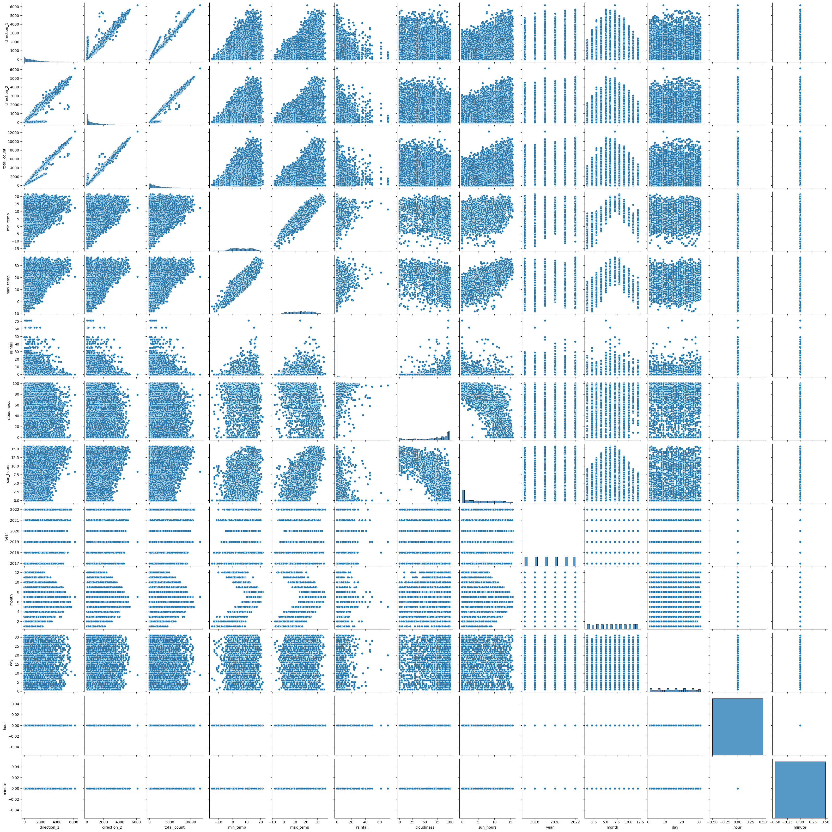
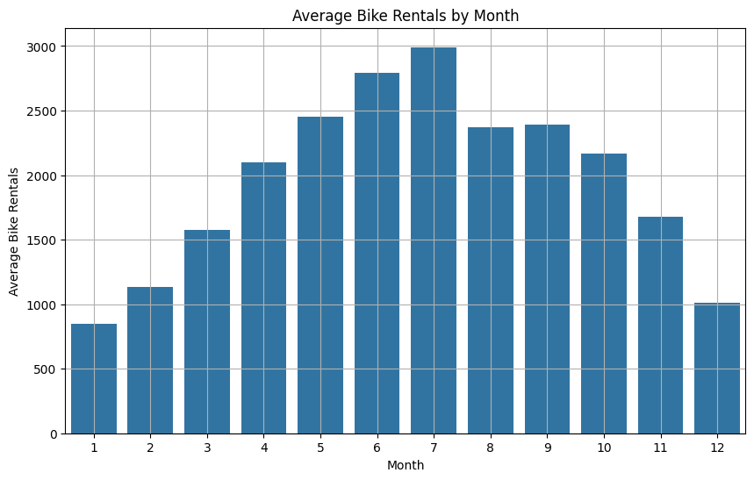
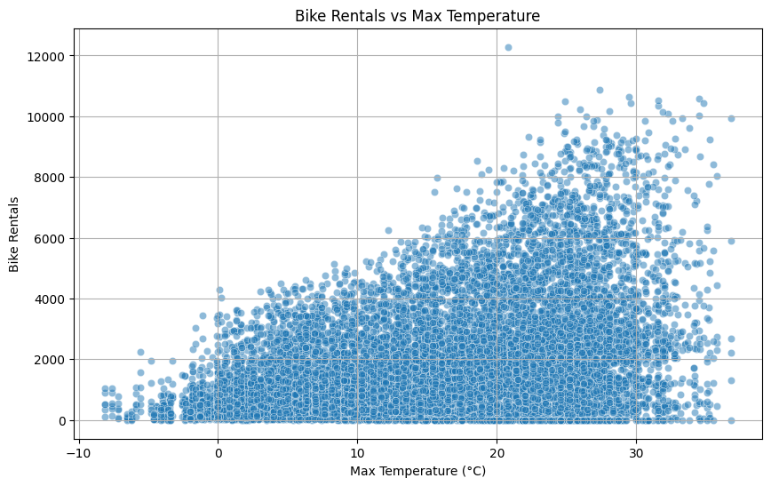
Exploratory Data Analysis
1.Pairplot showing relationships between variables
2.Bar Chart: Average bike rentals per month
3.Scatter plot: Relationship between max temp and rides.

Slide 5
Feature Engineering
Time-Based Feature Extraction:
Extracted year, month, day, hour, minute from datetime
Helps model capture seasonality, daily trends, and hourly patterns
Feature Selection:
Dropped unwanted features like direction_1,direction_2,counting_stations,date,starting_time,ending_time
Categorical Encoding:
Applied One-hot Encoding to counting stations
Converted station names into binary columns
Feature Scaling:
Scaled continuous numerical features using StandardScaler
Ensures features like temperature, sun hours and rainfall are on the same scale

Slide 6
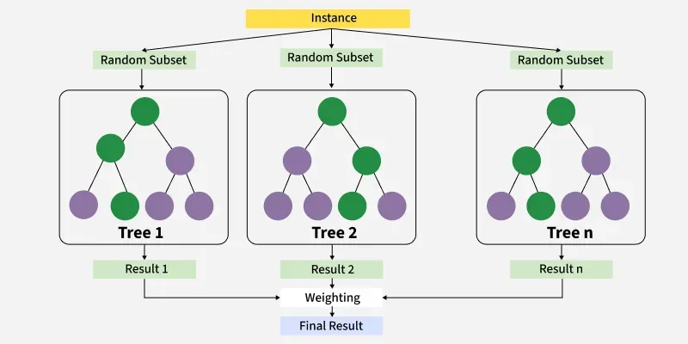
Model Overview: Algorithm Used : XGBoost Regressor XGBoost (Extreme Gradient Boosting) is a powerful and scalable tree-based ensemble algorithm used for regression and classification.
Why XGBoost?
Handles Non-Linear Relationships
Robust to Outliers
Built-in Regularization
Fast & Efficient
Feature Importance

Slide 7
Mathematics Behind XGBoost Algorithm
Prediction Formula:
XGBoost builds the model additively by combining predictions from K trees:
y^​i​=k=1∑K​fk​(xi​)
Where:
y^i = Predicted value for the ith data point
fk= Prediction function of the kth tree
K= Total number of trees
Objective Function:
Where:
l(yi,y^i) = Loss function (e.g., MSE for regression, log loss for classification)
Ω(fk)\Omega(f_k)Ω(fk​) = Regularization term for tree fk
Obj(θ)=i=1∑n​l(yi​,y^​i​)+k=1∑K​Ω(fk​)

Slide 8
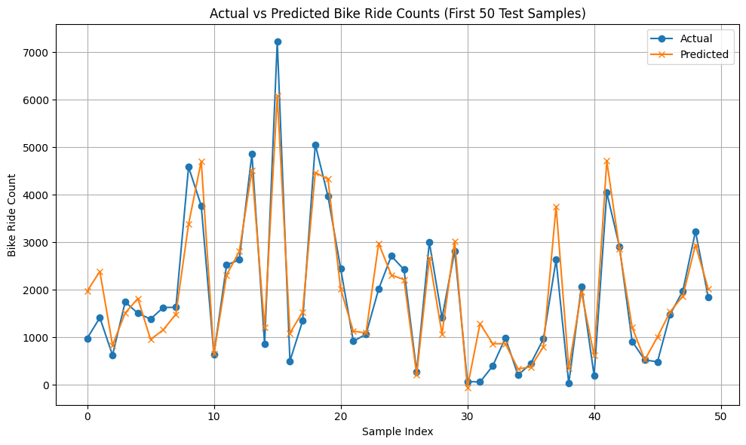
Model Evaluation
Metrics:
Mean Squared Error (MSE): 329785.19
R-squared (R2) Score: 0.90
Plot actual vs predicted values:

Slide 9
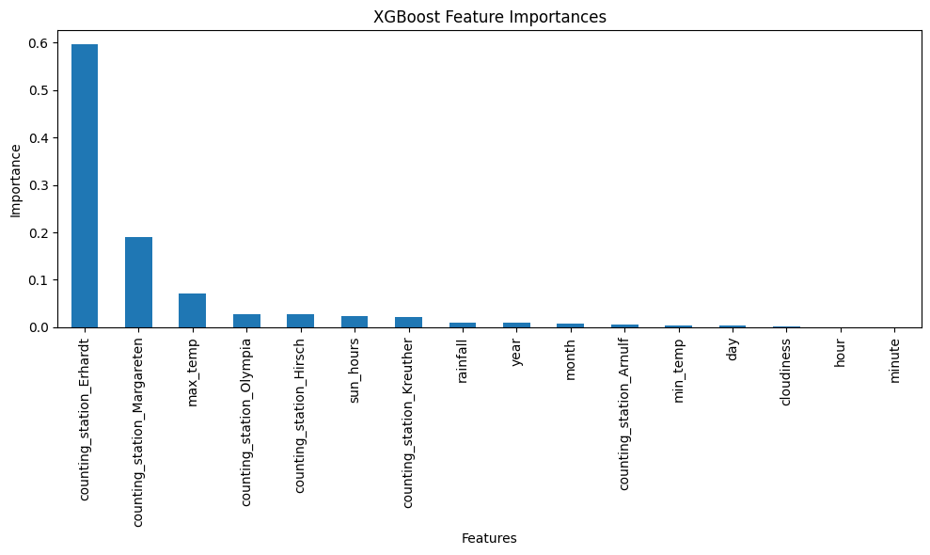
Insights:
Station location is the most powerful predictor.
Features like sun hours, rainfall, and temperature are strong predictors
Favorable weather = higher ride demand
Captures complex relationships between features
Overall, the model generalizes well to unseen data
Regularization avoids overfitting

Slide 10
Future Enhancements
Collect more real-time or hourly data
Add features: holiday info, special events, bike station info
Try hyperparameter tuning
Deploy as a dashboard (e.g., Streamlit or Power BI)

Slide 11
THANK YOU

